Slide 1
Git Introduction
Lorin Yeh

Slide 2
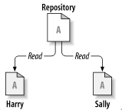
Harry and Sally get their own respective local Working Copies of the Master File in the Repository

Slide 3
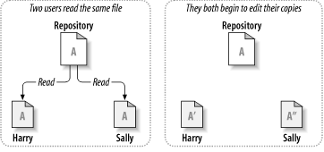
Harry adds some
method
Sally modifies some
other method

Slide 4
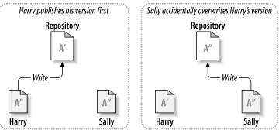

Slide 5
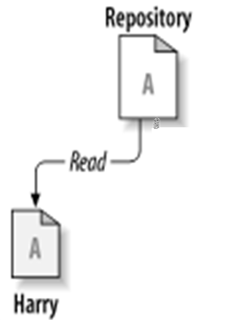
‘’
‘’
Harry’s local file gets overwritten with Sally’s latest changes.

Slide 6
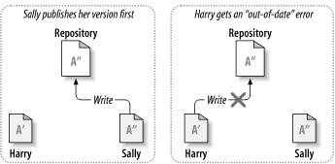

Slide 7
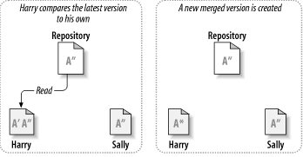

Slide 8
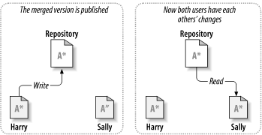

Slide 9
Outline
What is Git
Git Concepts
Git Basic Operations

Slide 10
What is Git
Version Control System
Centralized Version Control Systems
Distributed Version Control Systems

Slide 11
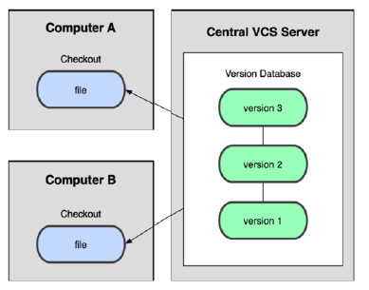
Centralized Version Control Systems
Drawbacks
Server or network down -> No one can work to collaborate
Database be corrupted -> Risk to lose everything

Slide 12
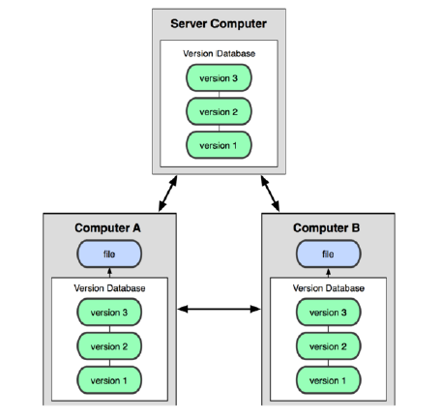
Distributed Version Control Systems

Slide 13
Distributed Version Control Systems
Advantage
Client fully mirror the repository
Good Elasticity
Can have many remote repositories
The user can collaborate with different groups of people in different ways simultaneously within the same project

Slide 14
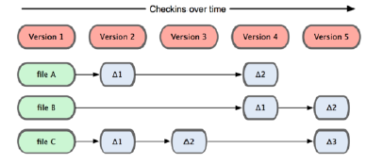
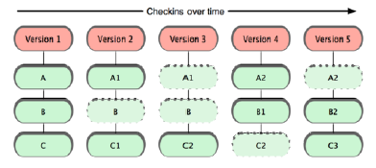
Git Basic Concepts
Snapshots, Not Differences

Slide 15
Git Basic Concepts
Nearly Every Operation Is Local
No need network
High speed
Can do them in every where, any time

Slide 16
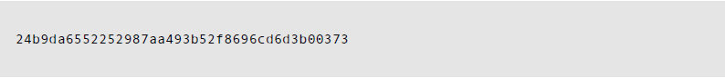
Git Basic Concepts
Git Has Integrity
Git uses a 40-character SHA-1 hash for
Integrity Checking
Reference Index

Slide 17
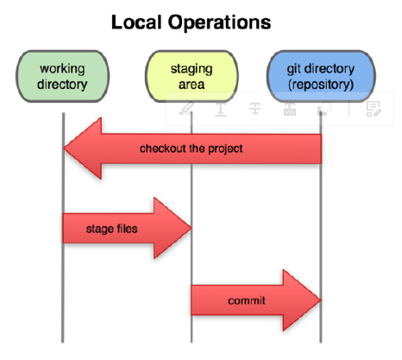

Slide 18
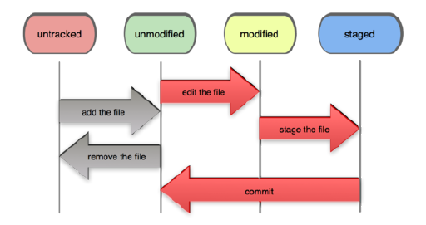
Git Basic Concepts
File States
committed(unmodified), modified and staged
untracked files

Slide 19
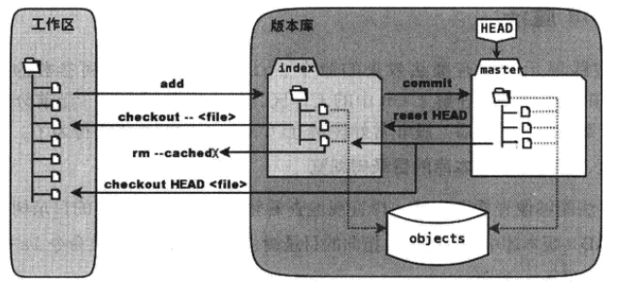
Local
Repository
Working Area
Staged Area

Slide 20
Git Basic Concepts
Local Computer
SCM Server
Local
Repository
Working
area
Staged
area
Version Database
Add/Edit
push
commit
version 3
version 3
file a
file a
version 2
pull
version 2
file b
file b
checkout
reset
version 1
version 1
Clone(pull + fetch)

Slide 21
Git Installation
In ubuntu Distribution
apt-get install git-core
In Windows
msysGit (Command Line)
TortoiseGit + msysGit (GUI)

Slide 22
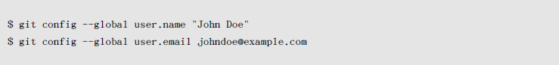
Git Installation
In ubuntu Distribution
First Time Git Setup
$ sudo apt-get install git
Configuring

Slide 23
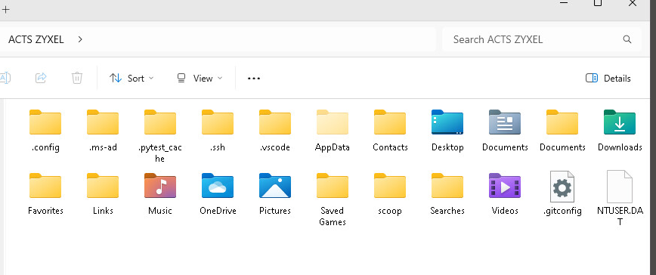
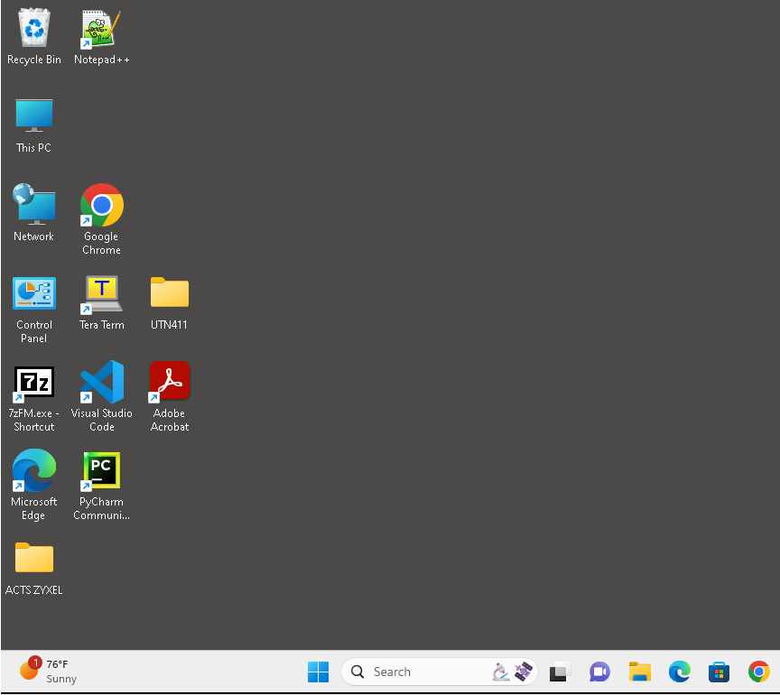

Slide 24
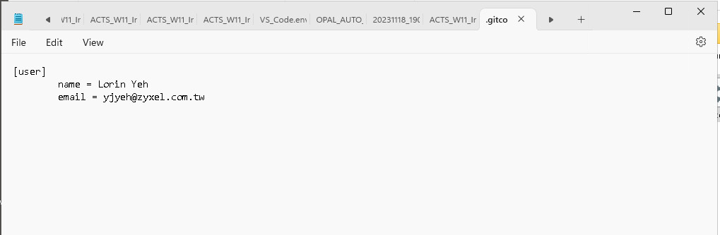

Slide 25
Bit Basic Operations
Using Git

Slide 26
Using Git
Git Command
~$ git [options] command [<args>]
Create New Git Repositories in Local
Initiate an empty repository
git init
For example,
~$ mkdir grit
~$ cd grit
~$ git init
A new folder .git has been created
grit
.git
branch
config
description
HEAD
……….

Slide 27
Using Git
Clone an Existing Repository
git clone
For example
~$ git clone git://github.com/schacon/grit.git
or
~$ git clone git://github.com/schacon/grit.git mygrit
mygrit.git
.git
REPOSITORIES
../grit.git
branch
config
description
HEAD
//github.com/schacon
……….
API.txt
Benchmarks.rb
……….

Slide 28
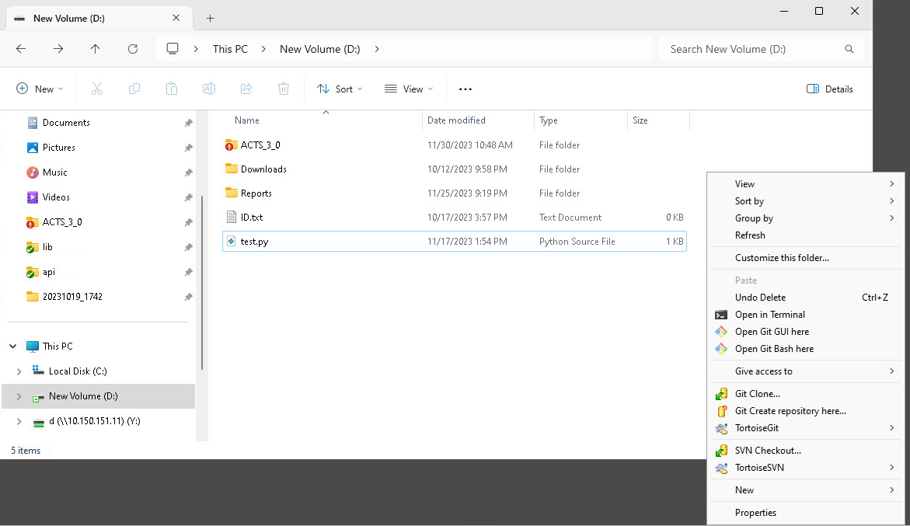

Slide 29
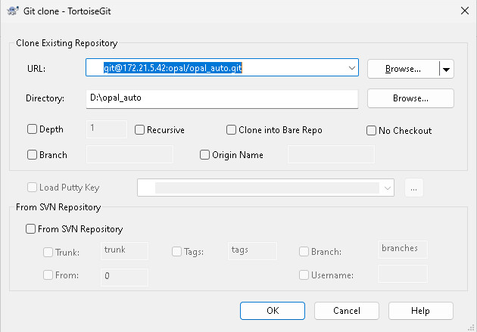

Slide 30
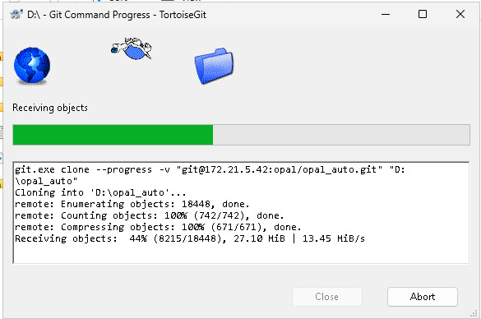

Slide 31
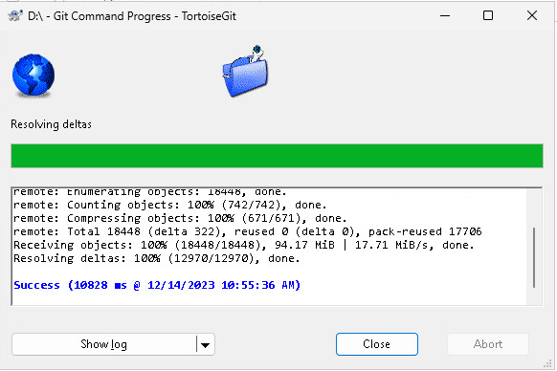

Slide 32
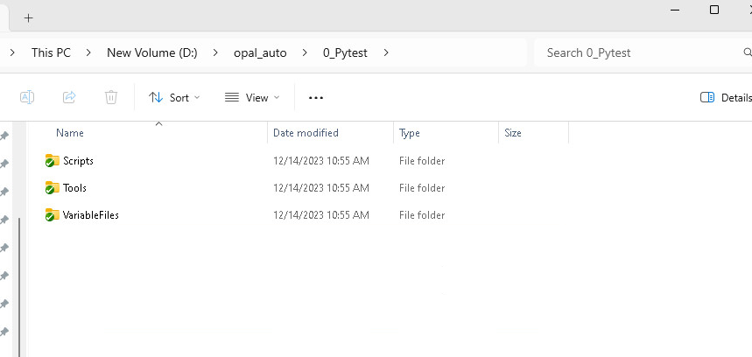

Slide 34
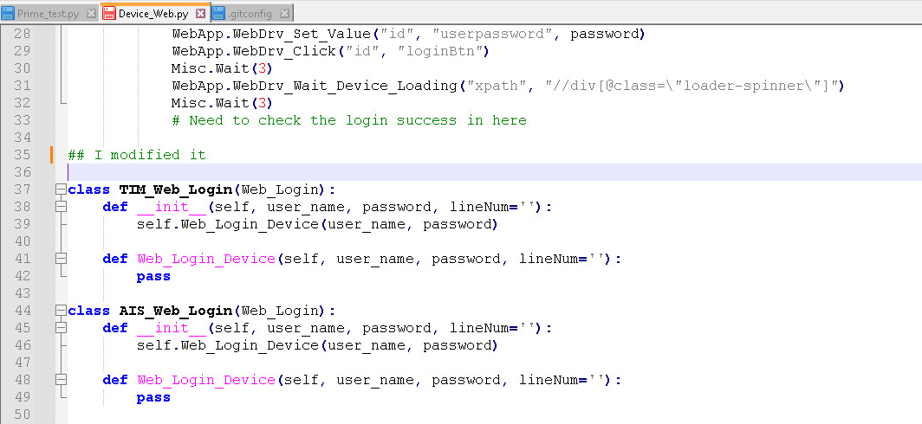

Slide 35
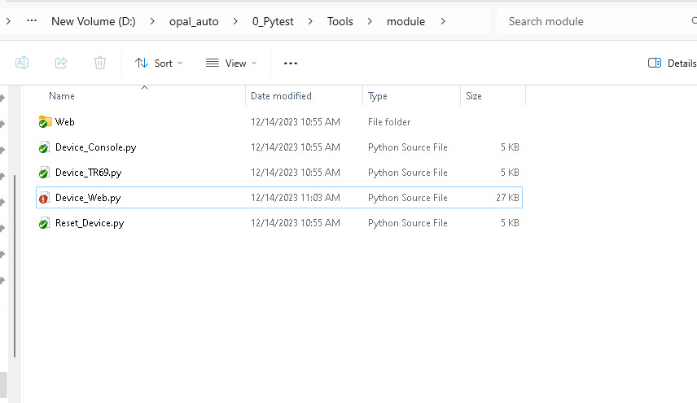

Slide 36
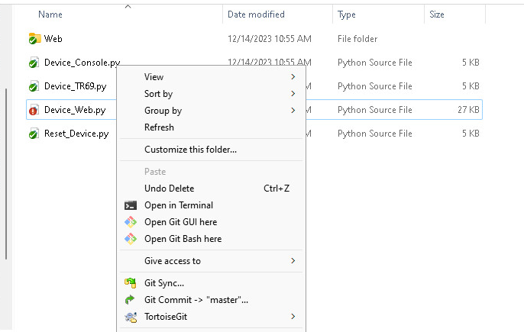

Slide 37
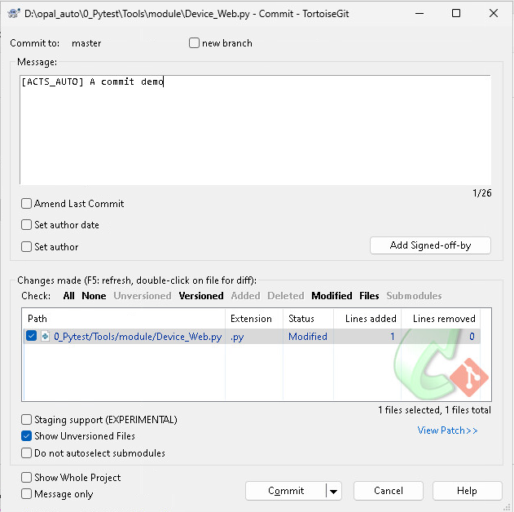

Slide 38
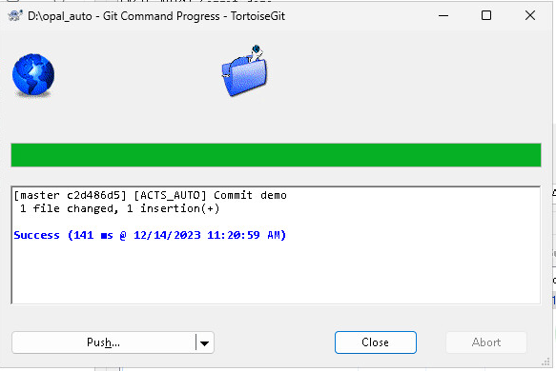
Push back to Server

Slide 39
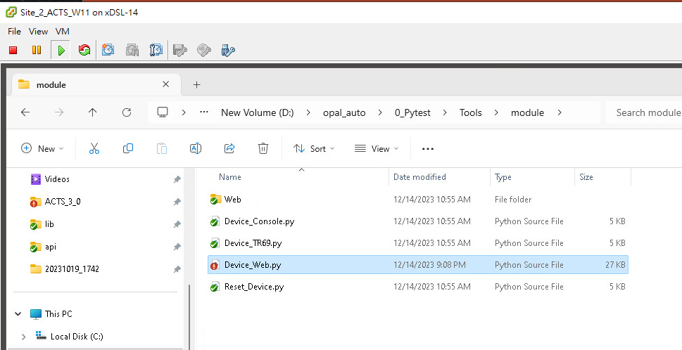
In Site_2_ACTS, I modified Device_Web.py

Slide 40
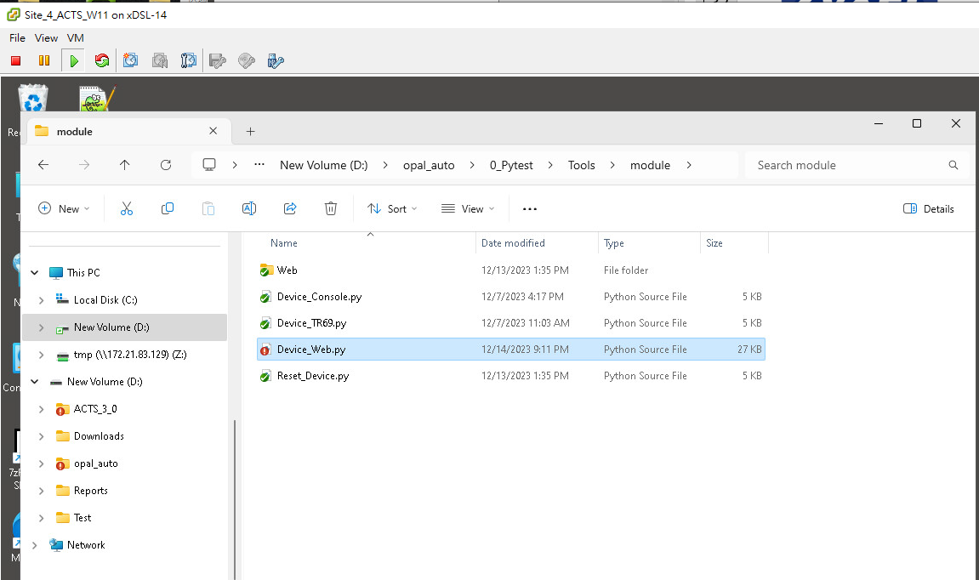
In Site_4_ACTS, another one also modified Device_Web.py

Slide 41
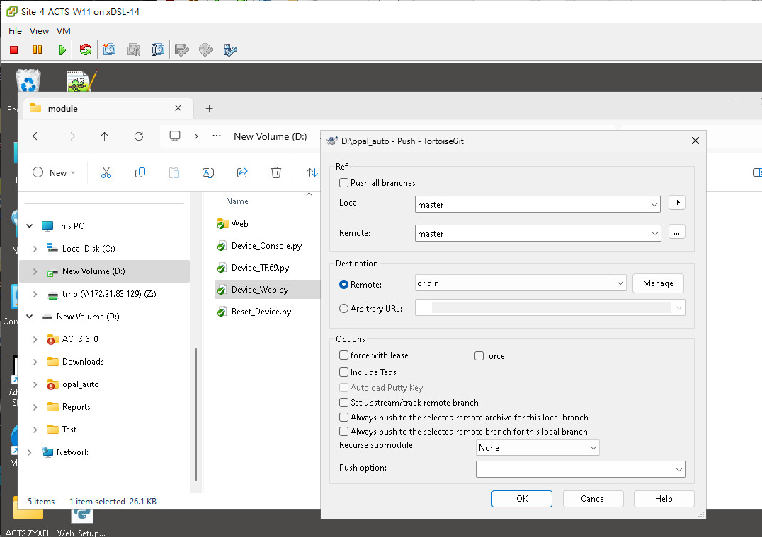
In Site_4_ACTS, Device_Web.py be committed and pushed back to server

Slide 42
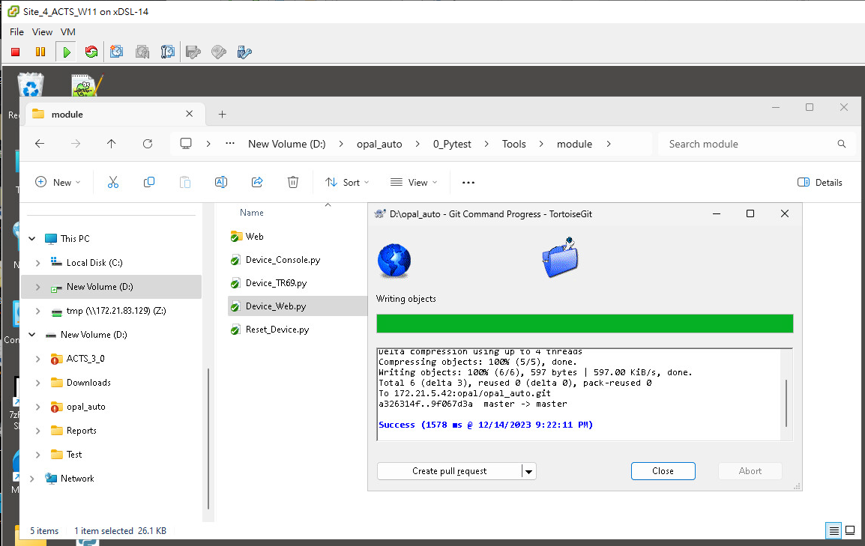

Slide 43
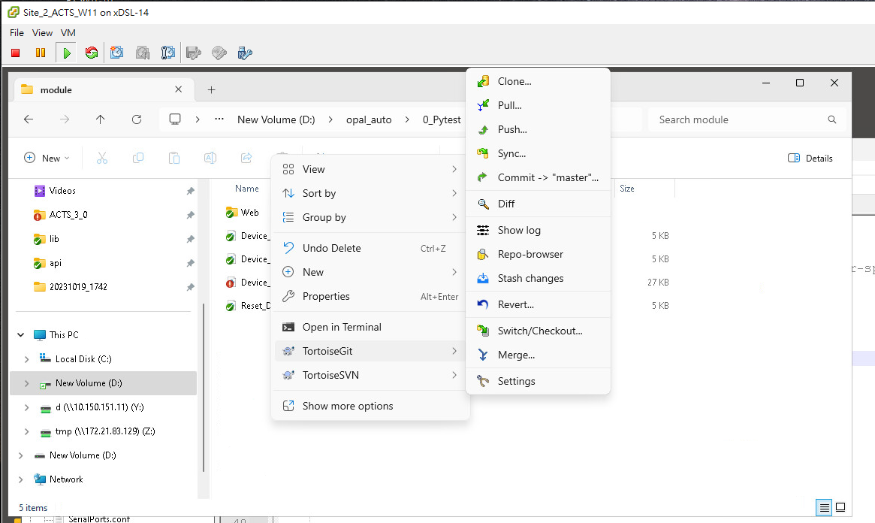
In Site_2_ACTS, please pull before commit

Slide 44
Git Basic Concepts
Local Computer
SCM Server
Local
Repository
Working
area
Staged
area
Version Database
Add/Edit
push
commit
version 3
version 3
file a
file a
version 2
pull
version 2
file b
file b
checkout
reset
version 1
version 1
Clone(pull + fetch)

Slide 45
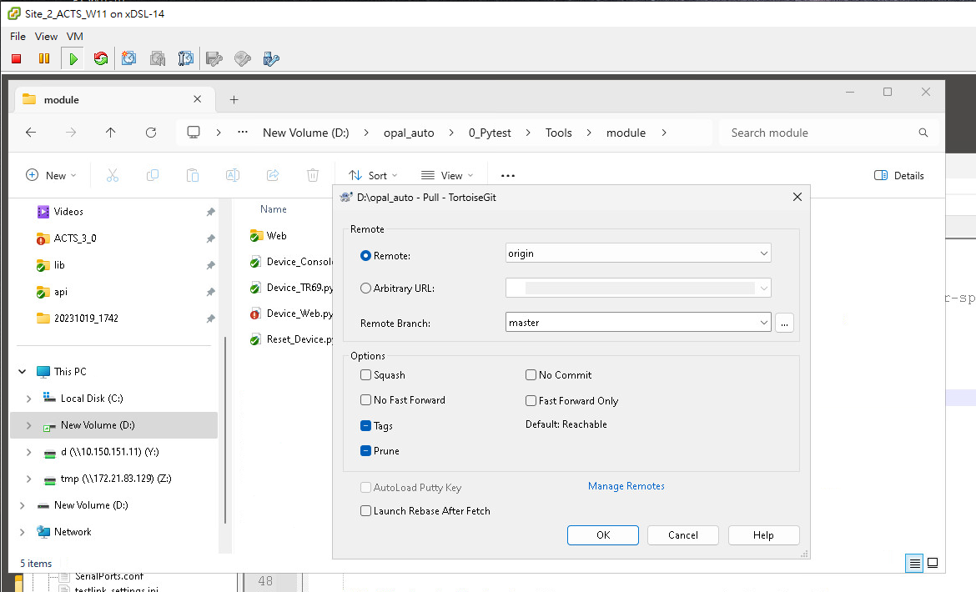

Slide 46
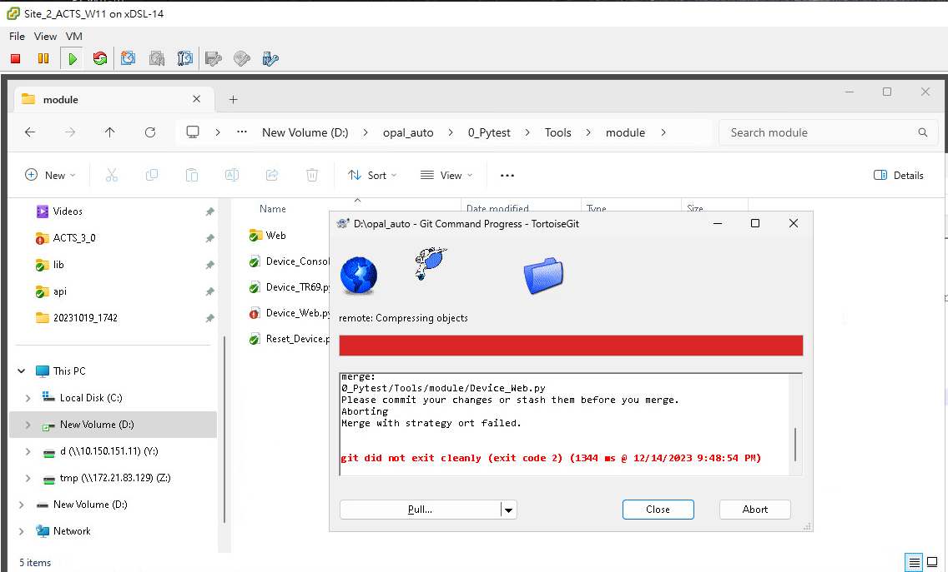

Slide 47
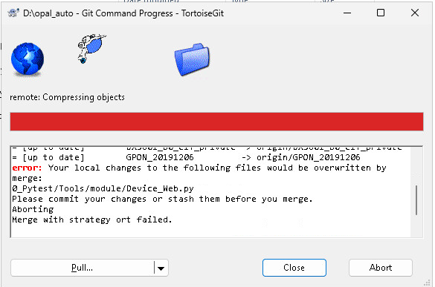

Slide 48
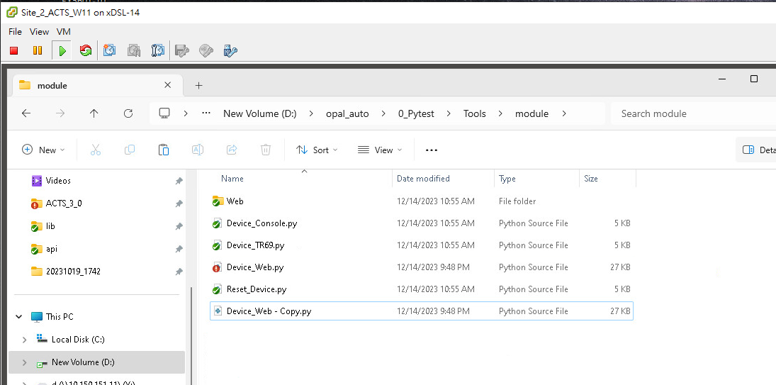
copy the target file

Slide 49
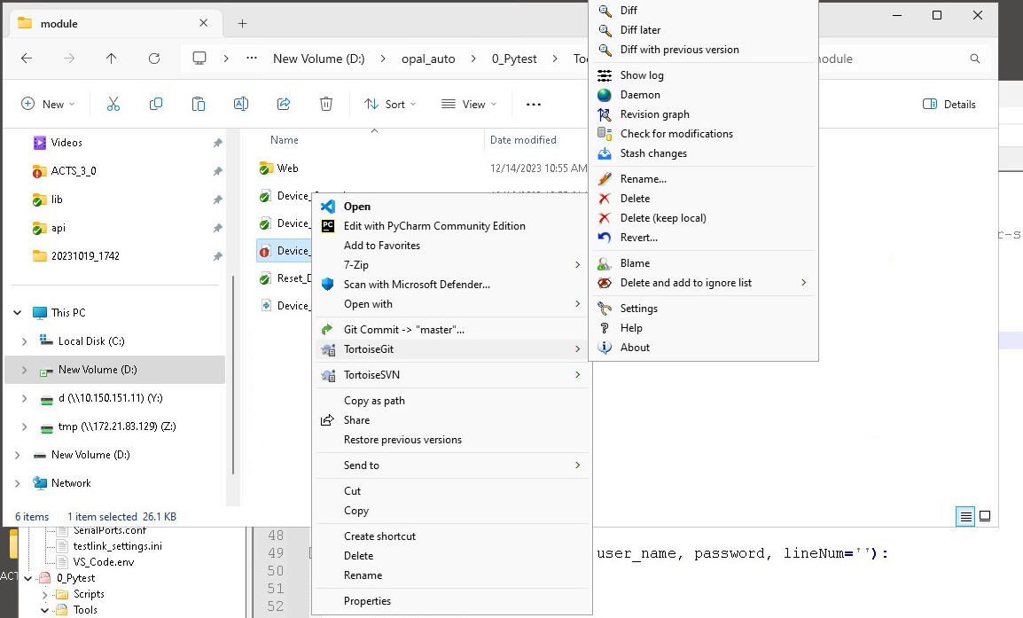
Revert the target file

Slide 50
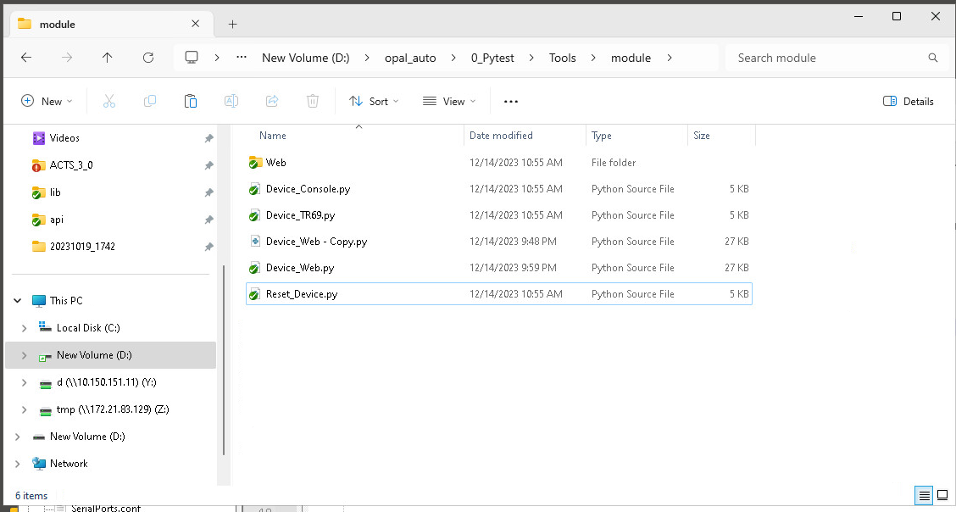
Go back the unmodified status

Slide 51
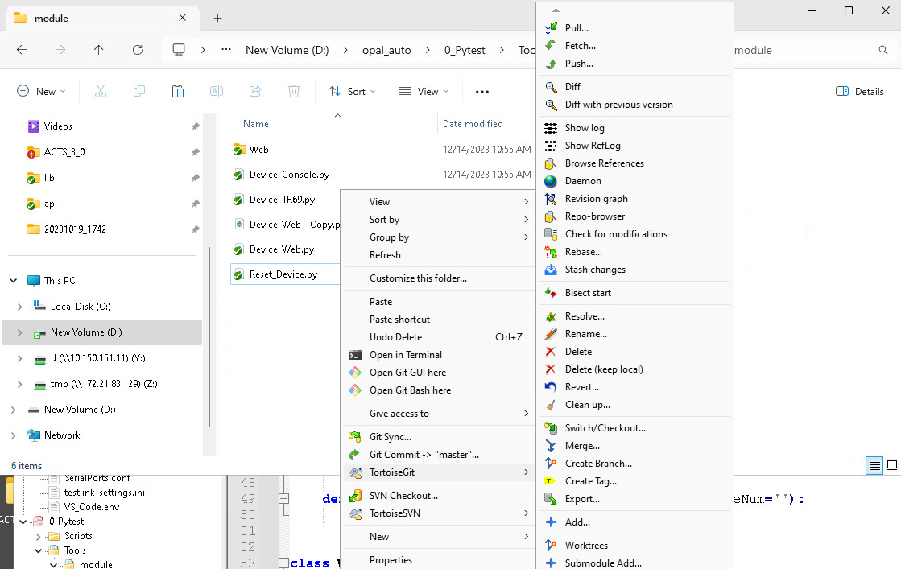
Pull the source trunk again

Slide 52
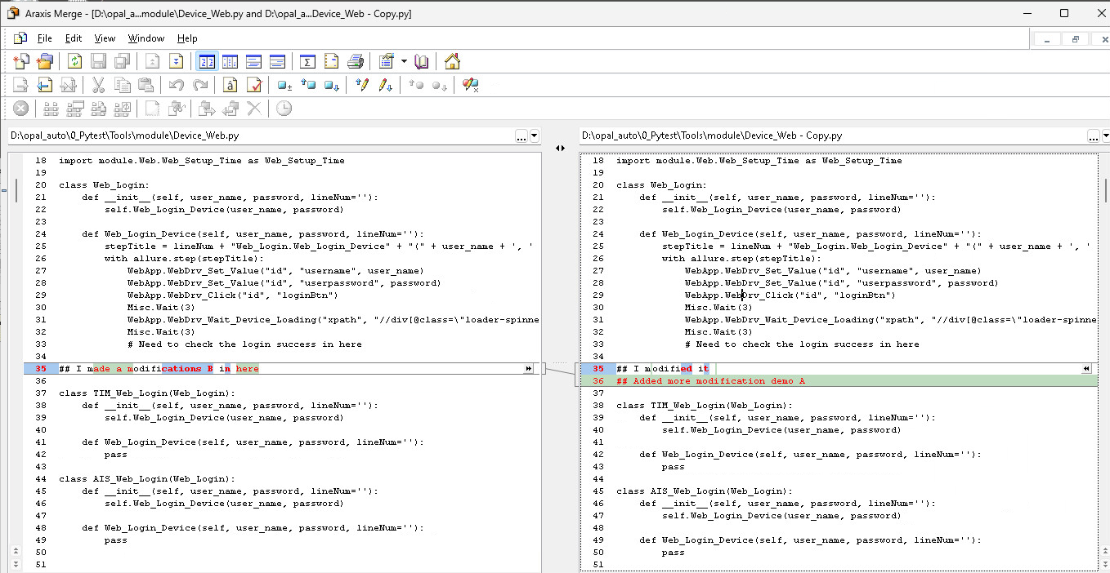
Launch a compare/merge tool
Modifications
In Site_4
Modifications
In Site_2

Slide 53
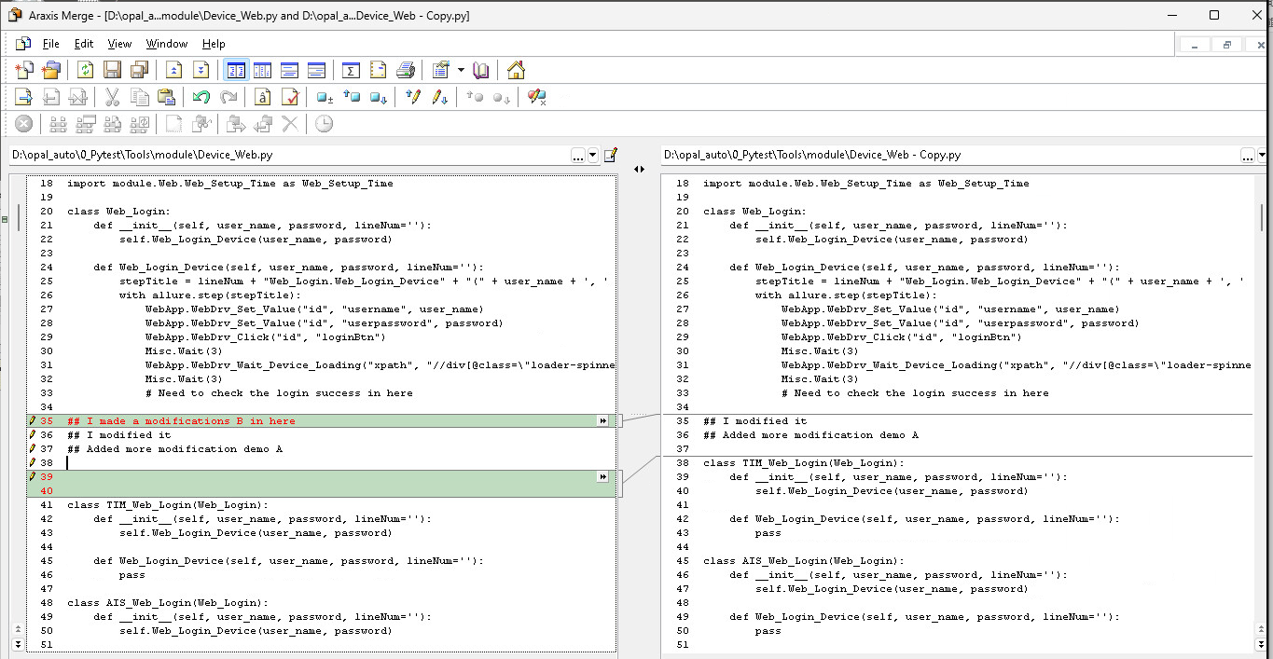
Launch a compare/merge tool
Merge them manually

Slide 54
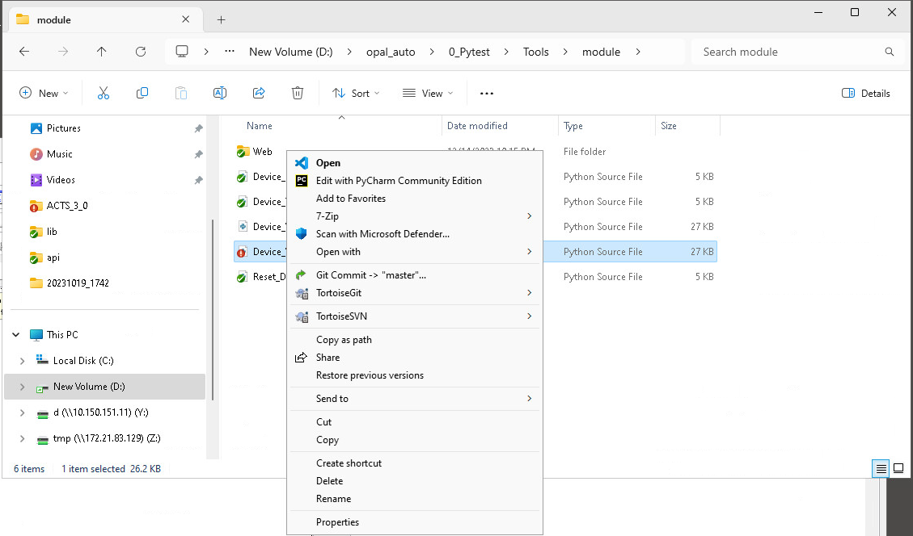
Launch a compare/merge tool
Commit and push again

Slide 55
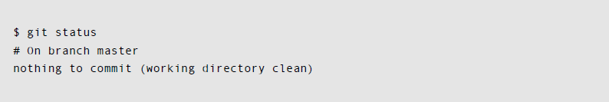
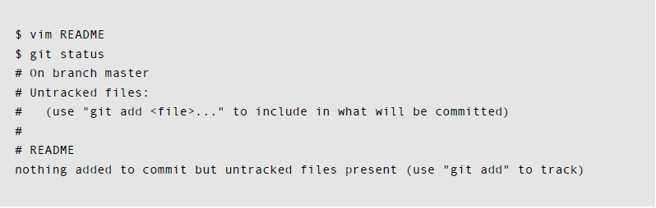
Using Git
Check The Status
git status
新增一個 README file
this file is untracked
only be in working area

Slide 56
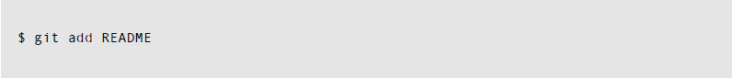
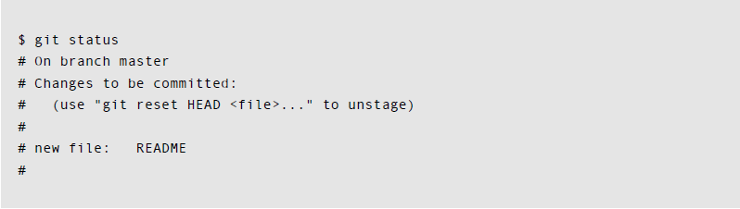
Using Git
Track New Files
git add
this file is tracked
被放入 staged area

Slide 57
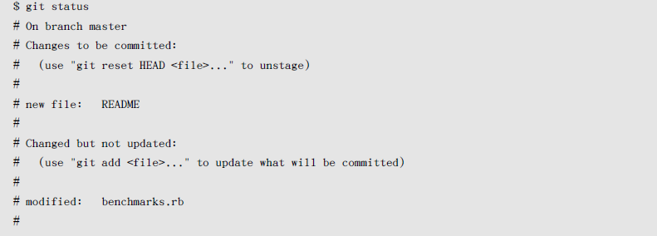
Using Git
Stage Modified Files
git add
修改 benchmark.rb file
此 file modified
README is in
staged area
Benchmarks.rb is only in
working area

Slide 58
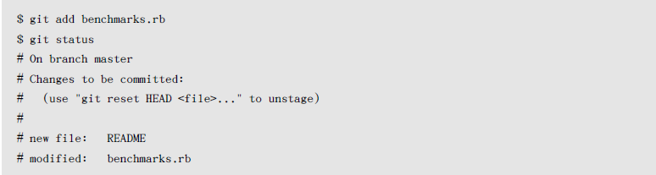
Using Git
Stage Modified Files
git add
README and benchmark.rb are in
staged area

Slide 59

Using Git
Stage Modified Files
第二次修改 benchmark.rb file
第一次修改的 benchmark.rb is in
staged area
第二次修改的 benchmark.rb is only in
working area

Slide 60
Using Git
Stage Modified Files
git add
再 added 一次benchmark.rb
修改兩次的benchmark.rb be in
staged area

Slide 61
Using Git
Check Difference between Modified & Staged File
git diff
修改 benchmark.rb file
僅存在 working area

Slide 62

Using Git
Check Difference between Modified & Staged File
git diff

Slide 63

Using Git
Check Difference between Staged File & Repositories
git diff --cached

Slide 64

Using Git
Check Difference
Working Area
Staged Area
Repository

Slide 65
Using Git
Commit
git commit

